Slide 1
CSC 2224: Parallel Computer Architecture and Programming Main Memory Fundamentals
Prof. Gennady Pekhimenko
University of Toronto
Fall 2019
The content of this lecture is adapted from the slides of
Vivek Seshadri, Donghyuk Lee, Yoongu Kim,
and lectures of Onur Mutlu @ ETH and CMU

Slide 2
Tiered-Latency DRAM: A Low Latency and Low Cost DRAM Architecture
Donghyuk Lee, Yoongu Kim, Vivek Seshadri, Jamie Liu, Lavanya Subramanian, Onur Mutlu
Published in the proceedings of 19th IEEE International Symposium on
High Performance Computer Architecture 2013

Slide 3
DRAM Stores Data as Charge
DRAM cell
Three steps of charge movement
1. Sensing
2. Restore
3. Precharge
Sense amplifier
Notes:
The right figure shows DRAM organization which is consists of DRAM cells and sense-amplifiers.
There are three steps for accessing DRAM.
First, when DRAM selects one of rows in its cell array, the selected cells drive their charge to sense-amplifiers.
Then, sense-amplifiers detect the charge, recognizing data of cells.
We call this operation as sensing.
Second, after sensing data from DRAM cells, sense-amplifiers drive charge to the cells for reconstructing original data.
We call this operation as restore.
Third, after restoring the cell data, DRAM deselects the accessed row and puts the sense-amplifiers to original state for next access.
We call this operation as precharge.
As shown in these three steps, DRAM operation is charge movement between cell and sense-amplifier.

Slide 4
DRAM Charge over Time
cell
cell
Data 1
charge
Sense amplifier
Sense amplifier
Data 0
Timing Parameters
Sensing
Restore
time
In theory
margin
In practice
Why does DRAM need the extra timing margin?
Notes:
Timing parameters exist to ensure sufficient movement of charge.
The figure shows the timeline for accessing DRAM in X-axis and Y-axis shows the charge amount in DRAM cell and sense-amplifier.
When selecting a row of cells, each cell drives their charge toward to the corresponding sense-amplifier.
If driven charge is more than enough to detect the data, the sense-amplifier starts to restore data by driving charge toward the cell.
This restore operation finishes when the cell is fully charged.
Ideally, DRAM timing parameters are just enough for the sufficient movement of charge.
However, in practice, there are large margin in DRAM timing parameters.
Why are these margin required?

Slide 5
Two Reasons for Timing Margin
1. Process Variation
DRAM cells are not equal
Leads to extra timing margin for cell that can store small amount of charge
1. Process Variation
DRAM cells are not equal
Leads to extra timing margin for cells that can store large amount of charge
1. Process Variation
DRAM cells are not equal
Leads to extra timing margin for cell that can store small amount of charge;
2. Temperature Dependence
DRAM leaks more charge at higher temperature
Leads to extra timing margin when operating at low temperature
Notes:
There are two reasons for the margin in DRAM timing parameters.
First is process variation and second is temperature dependence.
Let me introduce the first factor, process variation.

Slide 6
DRAM Cells are Not Equal
Ideal
Real
Smallest cell
Largest cell
Same size →
Different size →
Large variation in cell size →
Same charge →
Different charge →
Large variation in charge →
Same latency
Different latency
Large variation in access latency
Notes:
Ideally, DRAM would have uniform cells which have same size, thereby having same access latency.
Unfortunately, due to process variation, each cell has different size, thereby having different access latency.
Therefore, DRAM shows large variation in both charge amount in its cell and access latency to its cell.

Slide 7
Two Reasons for Timing Margin
1. Process Variation
DRAM cells are not equal
Leads to extra timing margin for cells that can store large amount of charge
2. Temperature Dependence
DRAM leaks more charge at higher temperature
Leads to extra timing margin when operating at low temperature
2. Temperature Dependence
DRAM leaks more charge at higher temperature
Leads to extra timing margin when operating at low temperature
2. Temperature Dependence
DRAM leaks more charge at higher temperature
Leads to extra timing margin when operating at low temperature
Notes:
There are two reasons for the margin in DRAM timing parameters.
First is process variation and second is temperature dependence.
Let me introduce the first factor, process variation.

Slide 8
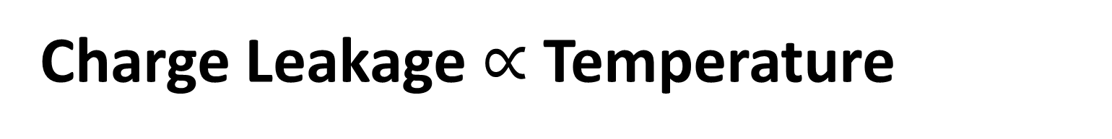
Charge Leakage $∝$ Temperature
Room Temp.
Hot Temp. (85°C)
Cells store small charge at high temperature
and large charge at low temperature
→ Large variation in access latency
Small leakage
Large leakage
Notes:
DRAM leakage increases the variation.
DRAM loses their charge over time and loses more charge at higher temperature.
Therefore, DRAM cell has smallest charge when operating at hot temperature, for example 85C which is the highest temperature guaranteed by DRAM standard.
This temperature dependence increases the variation in DRAM cell charge.

Slide 9
DRAM Timing Parameters
DRAM timing parameters are dictated by the worst case
The smallest cell with the smallest charge in all DRAM products
Operating at the highest temperature
Large timing margin for the common case
Can lower latency for the common case

Slide 10
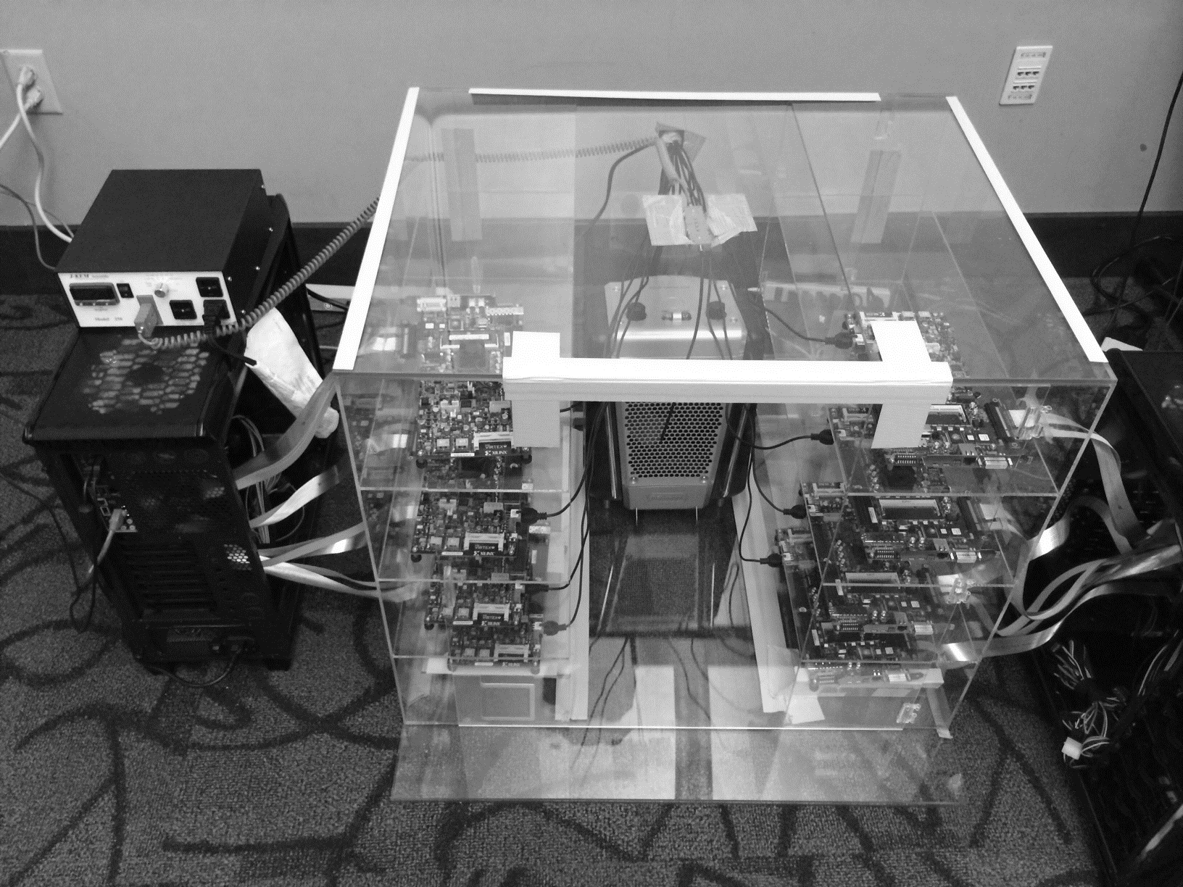
DRAM Testing Infrastructure
Temperature
Controller
FPGAs
Heater
FPGAs
PC
Notes:
This is the photo of our infrastructure, that we built mostly from scratch.
For higher throughput, we employ eight FPGAs, all of which are enclosed in thermally-regulated environment.

Slide 11
Obs 1. Faster Sensing
Timing
(tRCD)
17% ↓
No Errors
Typical DIMM at
Low Temperature
115 DIMM
characterization
More charge
Strong charge
flow
Faster sensing
Typical DIMM at Low Temperature
→ More charge → Faster sensing
Notes:
First step in DRAM operation is sensing.
In typical case, there are more charge in DRAM cell compared to the worst case.
The excessive charge enables stronger charge drive to sense-amplifier.
Then, sense-amplifier can detect data of DRAM cell fast, thereby complete sensing operation fast.
In our DRAM latency profiling results of 115 DRAM modules,
we observe that 17% potential reduction for the corresponding timing parameters of sensing.
As a result, more charge in typical cases lead to fast sensing.

Slide 12
Obs 2. Reducing Restore Time
115 DIMM
characterization
Typical DIMM at
Low Temperature
Read (tRAS)
37% ↓
Write (tWR)
54% ↓
No Errors
Larger cell &
Less leakage ➔
Extra charge
No need to fully
restore charge
Typical DIMM at lower temperature
→ More charge → Restore time reduction
Notes:
Second step in DRAM operation is restore.
Due to larger size and less leakage, typical DRAM cells have more charge than the worst cell.
Even though typical DRAM does not restore the excessive charge during restore operation,
eventually the typical cell has more charge than the worst case cell, guaranteeing reliable operations.
By reducing this restore time in DRAM read/write, our DRAM latency characterization shows significant potential to reduce corresponding timing parameters. For example, 37% for read and 54% for write.
As a result, more charge in typical cases enables restore time reduction.

Slide 13
Obs 3. Reducing Precharge Time
Typical DIMM at
Low Temperature
Sensing
Half
Precharge
Empty (0V)
Full (Vdd)
Bitline
Sense amplifier
Precharge ?
– Setting bitline to half-full charge
Notes:
Third step is precharge. Previously we explained the precharge simply as going back to original state.
Let me introduce more details about precharge.
To detect data in DRAM cell, DRAM has sense-amplifier and wire connection to the bitline.
DRAM preserve their a bit of data in two charge state, empty and fully charged.
During sensing and restore, the bitline moves to either of these two states.
After finishing the access, the bitline should be go back to the half of these two state.
We call this precharge. Unfortunately, bitline is usually long by connecting hundred of cells such that it takes long time for precharge.

Slide 14
Obs 3. Reducing Precharge Time
Access full cell
Access empty cell
Timing
(tRP)
35% ↓
No Errors
115 DIMM
characterization
Not fully precharged
More charge
→ strong sensing
Half
Empty (0V)
Full (Vdd)
bitline
Typical DIMM at Lower Temperature
→ More charge → Precharge time reduction
Notes:
Let us observe the impact of reducing precharge with a simple example.
The sense-amplifier first accesses an empty cell then not fully precharged by reducing corresponding timing parameter.
Then DRAM next access a fully charged cell.
Due to the bias in the bitline, it takes longer time to access the fully charged cell.
However, if the cell has much excessive charge, the strong charge flow overcomes the bias in the bitline, leading to reliable access.
Our DRAM latency evaluation shows that in typical case, we can reduce corresponding timing parameter by 35% without errors.
Therefore, more charge in typical cases enables precharge time reduction.

Slide 15
Adaptive-Latency DRAM
Key idea
Optimize DRAM timing parameters online
Two components
DRAM manufacturer profiles multiple sets of
reliable DRAM timing parameters at different temperatures for each DIMM
System monitors DRAM temperature & uses appropriate DRAM timing parameters
reliable DRAM timing parameters
DRAM temperature

Slide 16
Real System Evaluation
Average
Improvement
14.0%
10.4%
Performance Improvement
2.9%
all-35-workload
AL-DRAM provides high performance improvement, greater for multi-core workloads

Slide 17
Summary: AL-DRAM
Observation
DRAM timing parameters are dictated by the worst-case cell (smallest cell at highest temperature)
Our Approach: Adaptive-Latency DRAM (AL-DRAM)
Optimizes DRAM timing parameters for the common case (typical DIMM operating at low temperatures)
Analysis: Characterization of 115 DIMMs
Great potential to lower DRAM timing parameters (17 – 54%) without any errors
Real System Performance Evaluation
Significant performance improvement (14% for memory-intensive workloads) without errors (33 days)
Notes:
Let me summarize.
DRAM timing parameters are dictated by the worst case cell.
We propose Adaptive-Latency DRAM that optimizes DRAM timing parameters for common cases
Our characterization shows the significant potential to lower DRAM timing parameters.
Our real system evaluation shows that our mechanism provides significant performance improvement without introducing errors.

Slide 18
Adaptive-Latency DRAM: Optimizing DRAM Timing for the Common-Case
Donghyuk Lee, Yoongu Kim,
Gennady Pekhimenko, Samira Khan, Vivek Seshadri, Kevin Chang, and Onur Mutlu
Published in the proceedings of 21st
International Symposium on High Performance Computer Architecture 2015

Slide 19
Outline
What is DRAM?
DRAM Internal Organization
Problems and Solutions
Latency (Tiered-Latency DRAM, HPCA 2013;
Adaptive-Latency DRAM, HPCA 2015)
Parallelism (Subarray-level Parallelism, ISCA 2012)

Slide 20
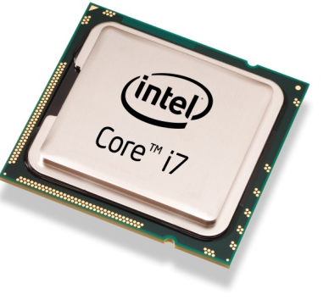
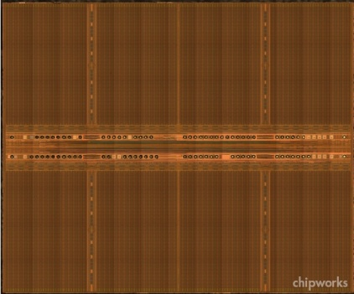
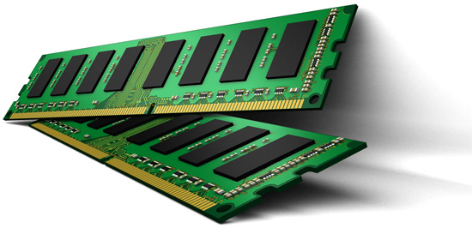
Parallelism: Demand vs. Supply
Demand
Supply
Out-of-order Execution
Multi-cores
Multiple
Banks
Prefetchers

Slide 21
Increasing Number of Banks?
Adding more banks → Replication of shared structures
Replication → Cost
How to improve available parallelism within DRAM?

Slide 22
Our Observation
Local to a subarray
1. Wordline enable
4. Charge restoration
2. Charge sharing
5. Wordline disable
3. Sense amplify
6. Restore sense-amps
Data Access
Time

Slide 23
Subarray-Level Parallelism
Row Decoder
Row Address
1
0
0
1
1
0
0
1
Time share
Replicate
Row Decoder
Row Address
Row Address
Column Read/Write

Slide 24
Subarray-Level Parallelism: Benefits
Two requests to different subarrays in same bank
Commodity DRAM
Data Access
Data Access
Time
Data Access
Data Access
Saved Time
Subarray-Level Parallelism

Slide 25
Results Summary
Commodity DRAM
Subarray-Level Parallelism
17%
19%

Slide 26
A Case for Exploiting Subarray-Level Parallelism (SALP) in DRAM
Yoongu Kim, Vivek Seshadri, Donghyuk Lee, Jamie Liu, Onur Mutlu
Published in the proceedings of 39th
International Symposium on Computer Architecture 2012

Slide 27
CSC 2224: Parallel Computer Architecture and Programming Main Memory Fundamentals
Prof. Gennady Pekhimenko
University of Toronto
Fall 2019
The content of this lecture is adapted from the slides of
Vivek Seshadri, Donghyuk Lee, Yoongu Kim,
and lectures of Onur Mutlu @ ETH and CMU

